Slide 1
Explorative Data Analysis Nexus Bank Case Study
By
Aimanehi Ehichioya

Slide 2
Content
Project Statement
Data Assessment
EDA
Conclusion
Recommendation
Limitation

Slide 3

Project Statement
Nexus Bank is a financial institution that provide banking solutions such as term deposit, personal loan and mortgage financing.
Nexus conducted a campaign to acquire more deposit. Therefore, they want to understand the following:
Customer demographics such as age, education and influences attitude towards deposit, loan acquisition and defaulting.
How effective was the recent campaign.

Slide 4
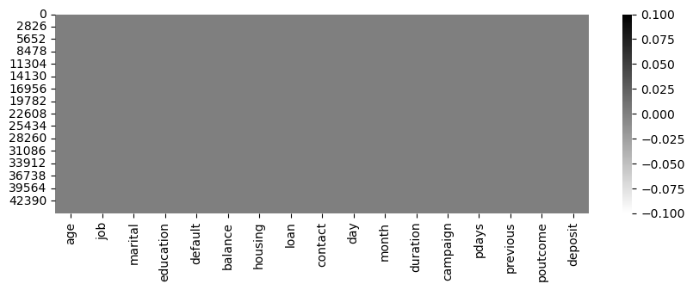
Data Cleaning
The datasets contain 45211 rows and 17 columns.
During assessment of the data, there are no entry of missing and duplicated values however there are unknown value which are considered to be Missing Not At Random (MNAR).

Slide 5
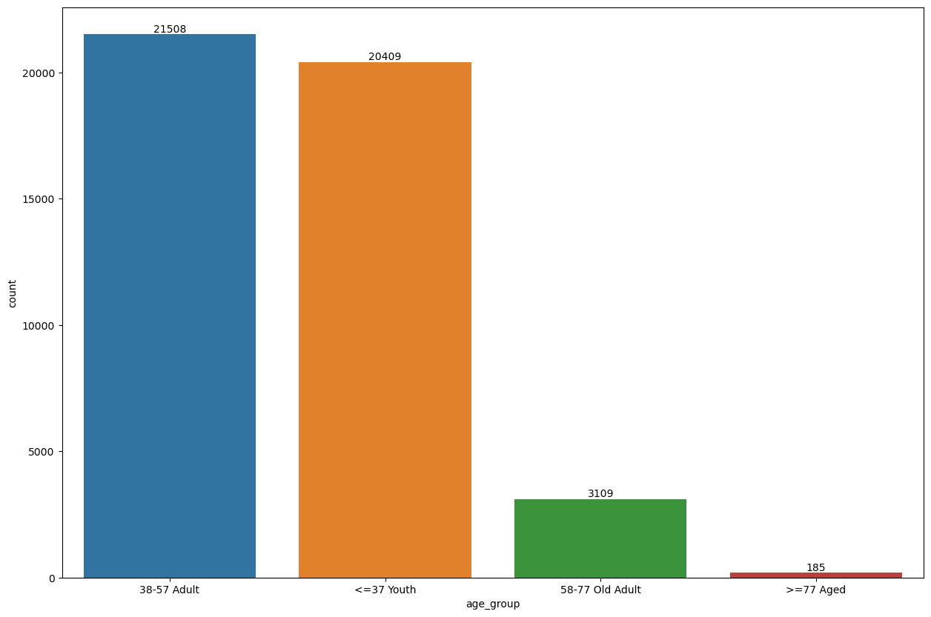
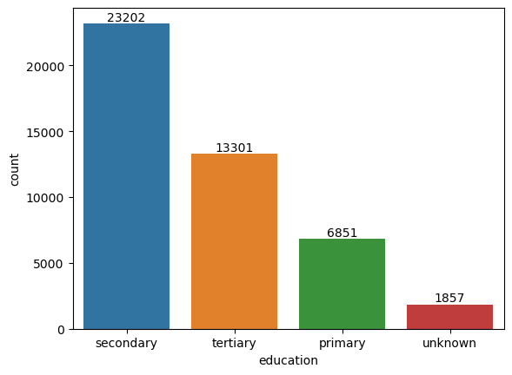
Analysis
Univariate Analysis
The age is divided into 4groups which includes Youth(18-37), Adult(38-57), Old Adult(58-77) and Aged(above 77).
The adult and the youth are the highest.
A large number of customer has a secondary and tertiary education.

Slide 6
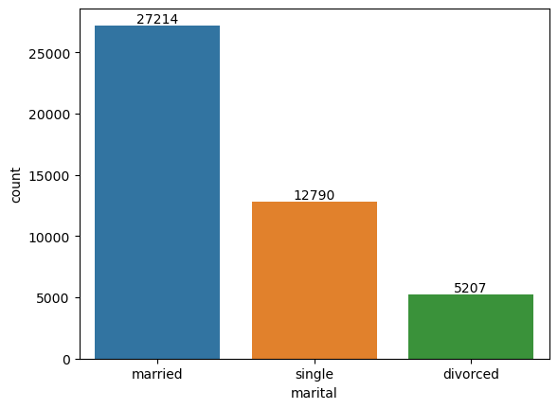
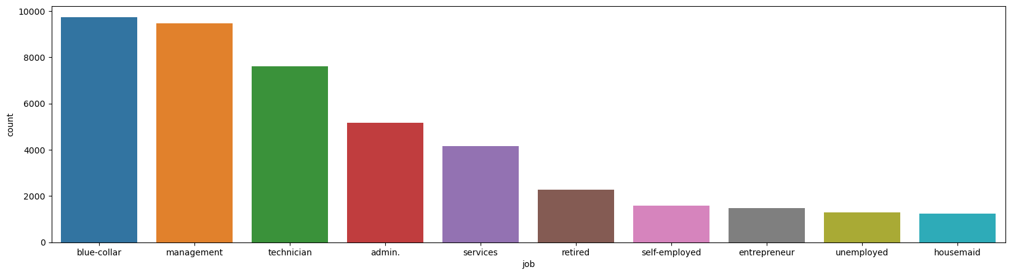
Number of customers by marital status and occupation. From the chart the customer base are those that are married, have blue collar and those who work in management.

Slide 7
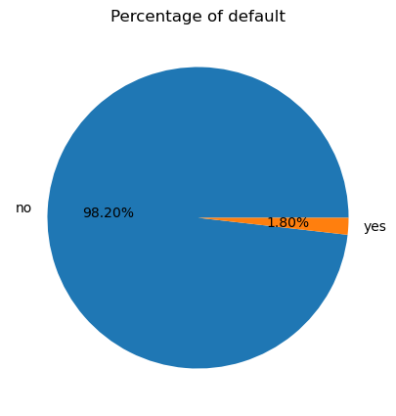
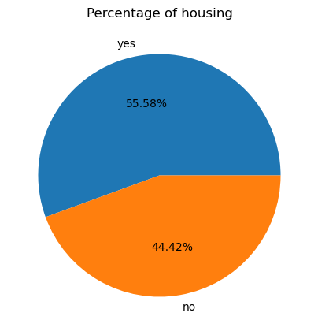
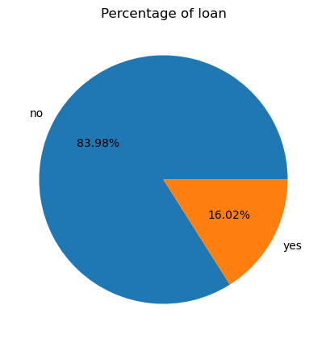
About 98% percentage of customers that took loan did not default
55% percentage of customers that took housing loan
83% percentage of customers that took loan. More customers took loan than housing.

Slide 8
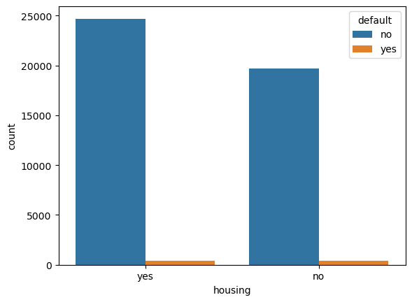
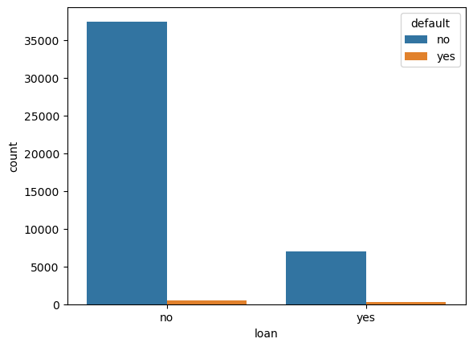
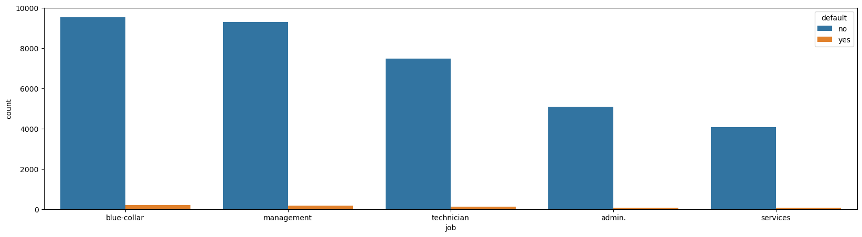
from this visualization the customer that took both housing and loan all paid the loan, by the job description and other demographic didn’t default.

Slide 9
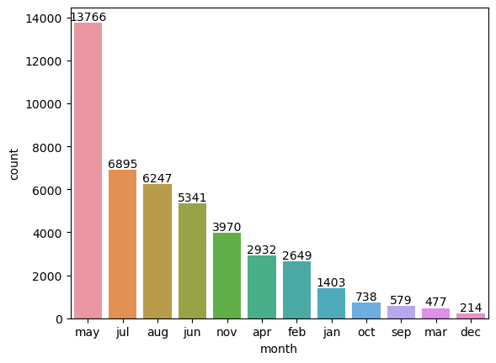
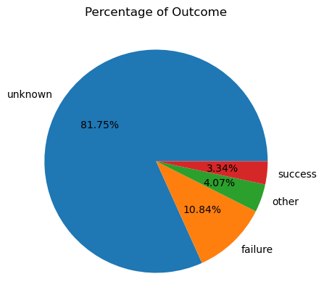
The previous outcome of the campaign was a failure given the percentage of unknown to be 80% and failure is 10%.
Analysis shows that the customers majority of the customer were contacted in second quarter of the year.

Slide 10
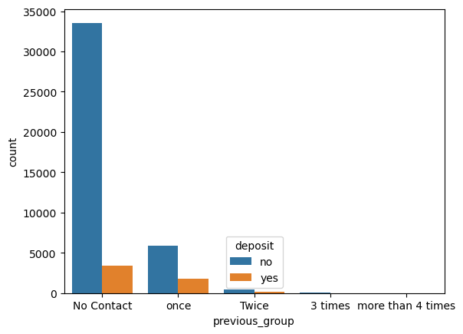
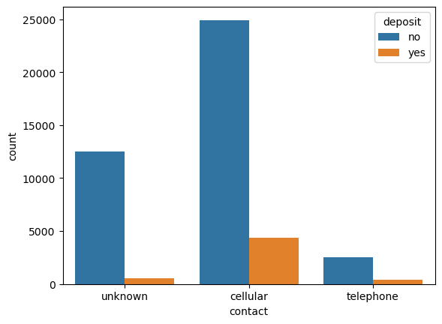
A lot of customers were contacted through cellular but few deposited
Analysis shows that most of Customers were not contacted hence could lead to low deposit.

Slide 11
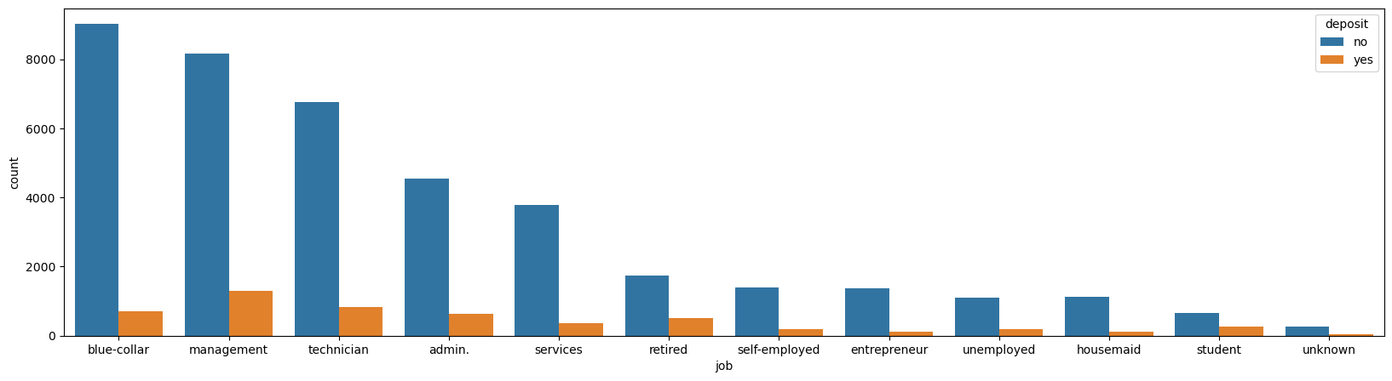
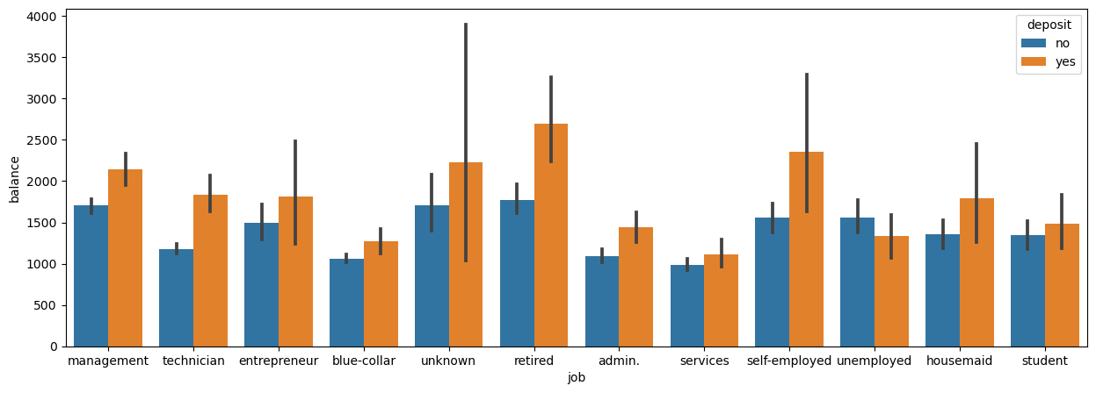
This chart shows that the occupation with the highest number of deposit are management, technicians, retired and students comparing it to the number of customer in the different occupation and those with high balance made deposits.

Slide 12
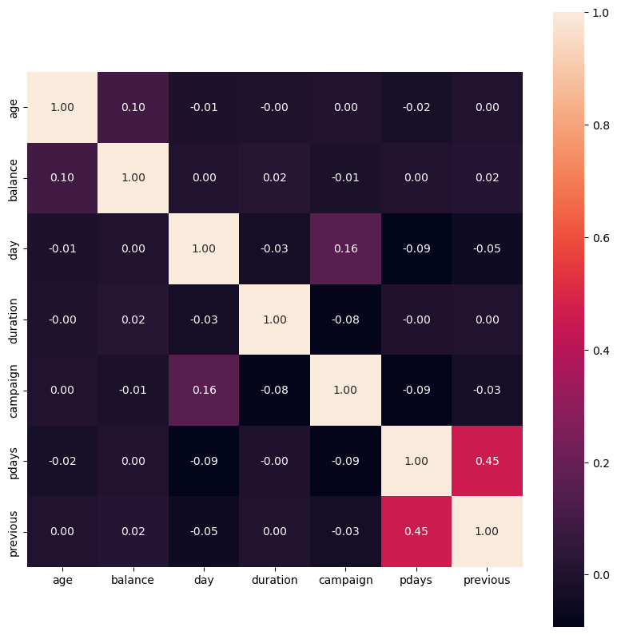
There is no correlation within the dataset except the number of days that passed by after the customer was last contacted and the number of contacts made to the customer before this campaign.

Slide 13
Conclusion
Analysis the dataset the customer demographic to loan acquisition and defaulting is high default

Slide 14
LIMITATION
In the dataset there are many unknown or other values in some of the key column which could lead the analysis to be biased.

Slide 15
Thank you

Slide 16
Recommendation
t
JAN 20XX
coordinate e-business applications
MAR 20XX
foster holistically superior methodologies
MAY 20XX
deploy strategic networks with compelling e-business needs

